Slide 1

Internship project-2
Abhinav suman
2020kucp1052@iiitkota.ac.in

Slide 2
Hosting MERN applications on AWS by Creating CICD Pipeline Configuring Virtual Private Server via AWS Amplify
Prerequisites
1.AWS account
2.Git and github
3.Mongodb
4.Putty
5.Vscode

Slide 3
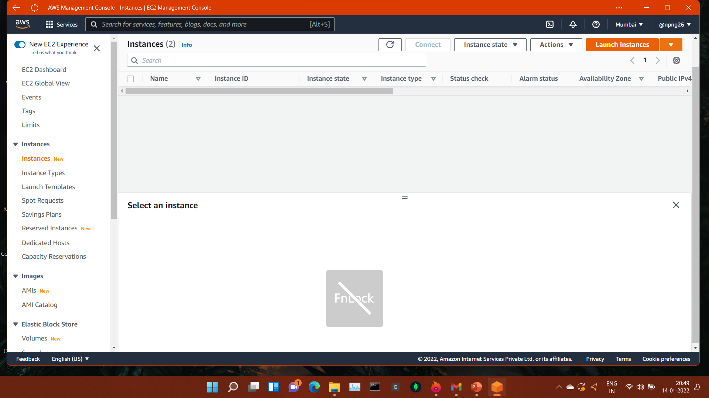
Open aws and click on ec2 instance .
Click on launch instance to start creating an instance.

Slide 4
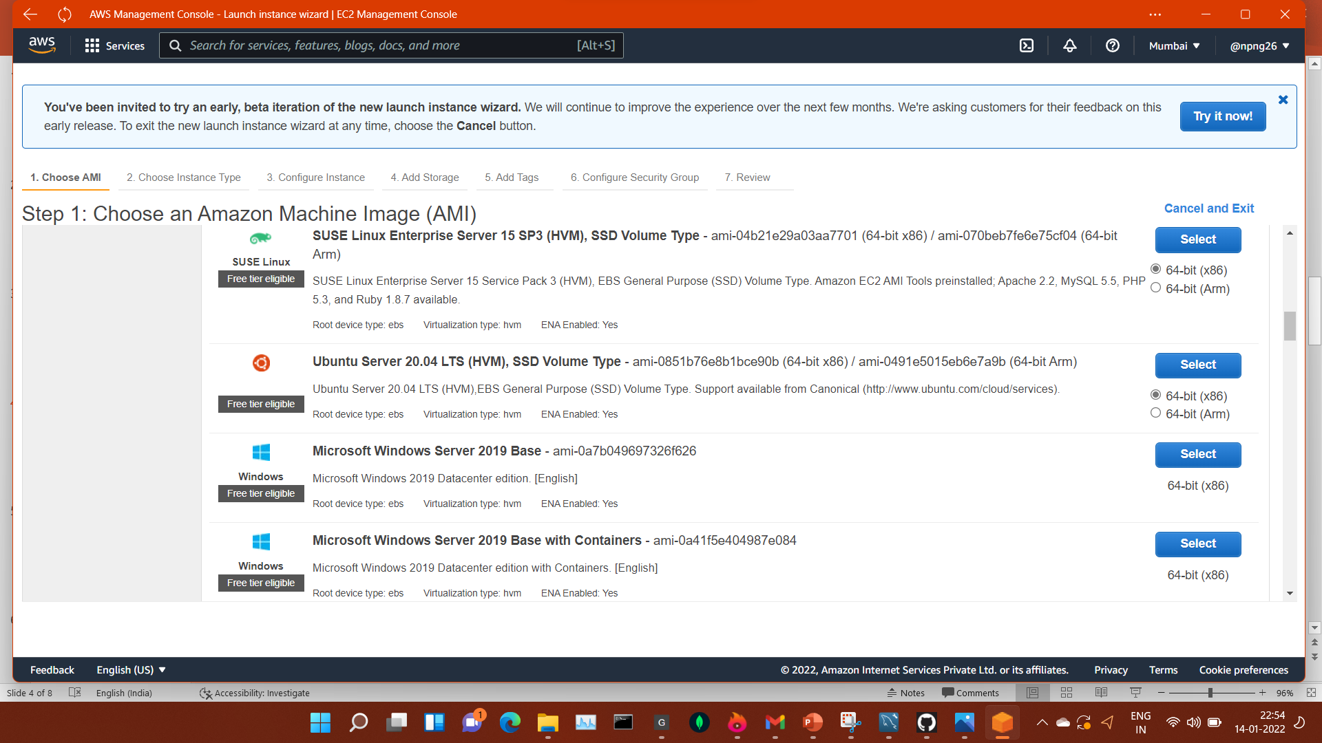
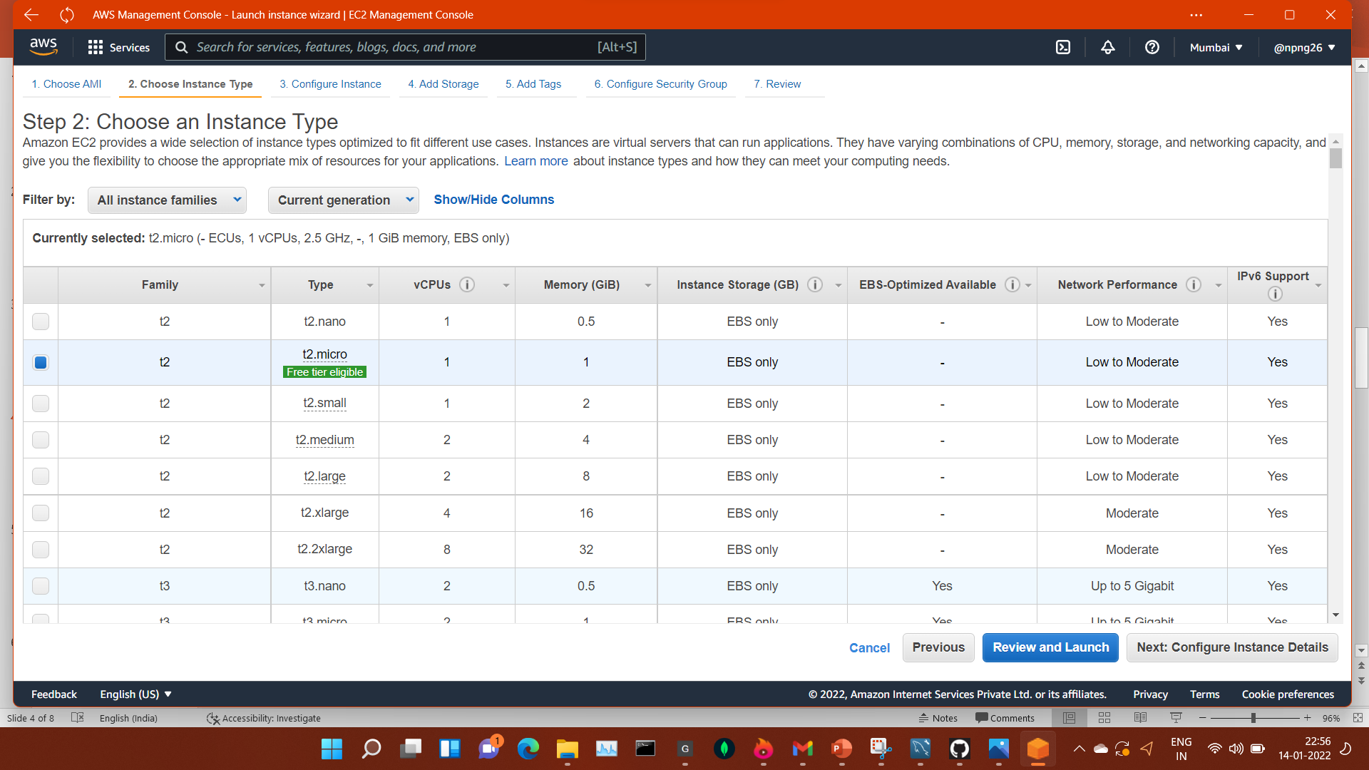
Choose an AMI(here we choose ubuntu)
Choose an instance type(we choose free tier t2.micro) and Configure an instance

Slide 5
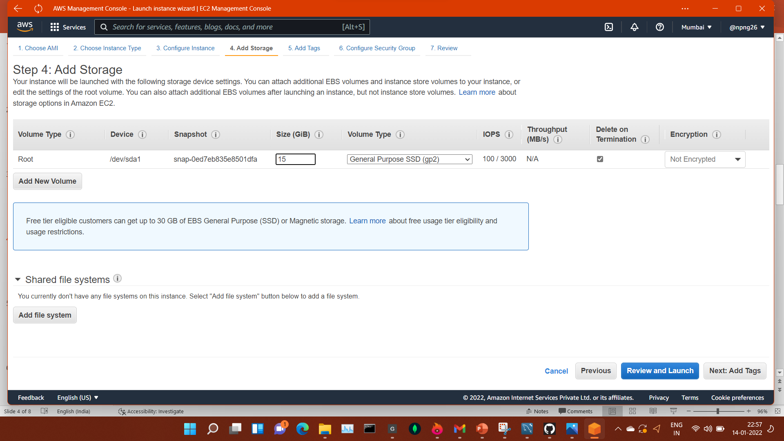
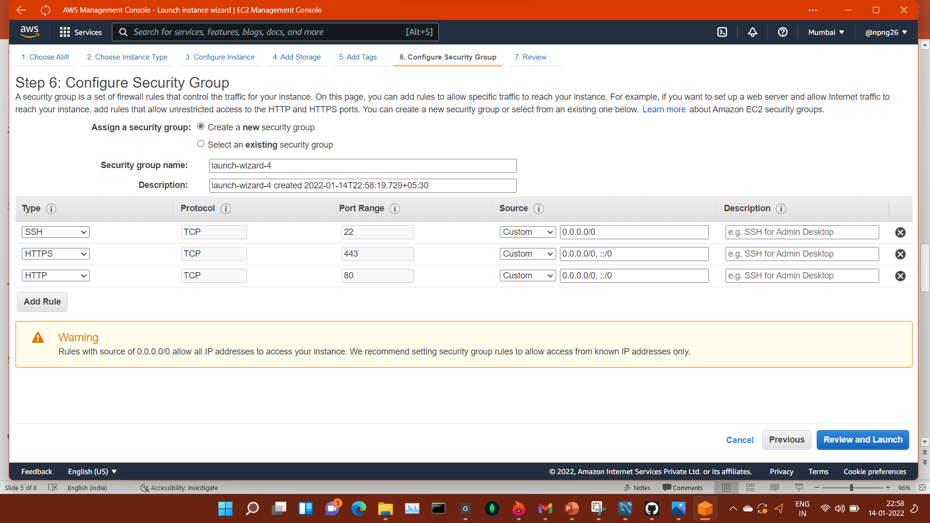
Add storage size(15gb) and storage type(gp-2 ssd) and then add tags
Now we add security groups and configure them.

Slide 6
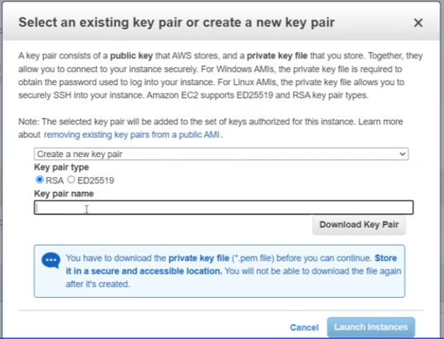
Now we create and download the keypair for this instance.
I name this instance as MernStackServer

Slide 7
After the instance created we need to change this dynamic IP into the static IP using elastic Ips.
After that associate this elastic ip to the instance that is created.

Slide 8
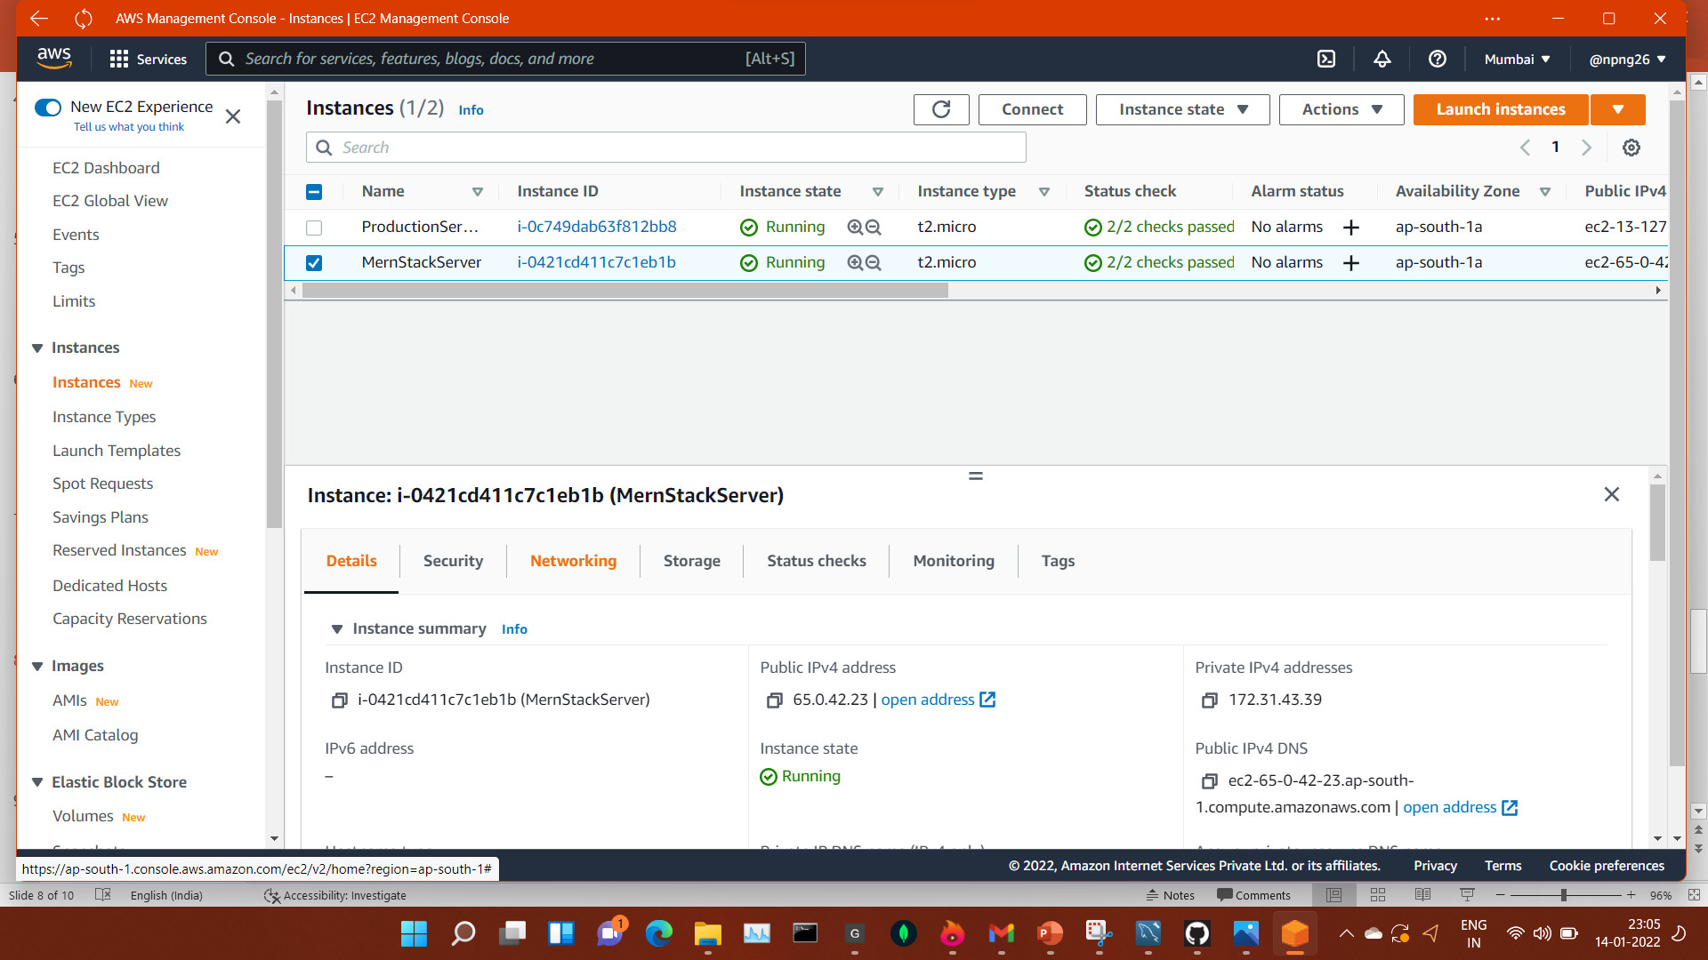

Slide 9
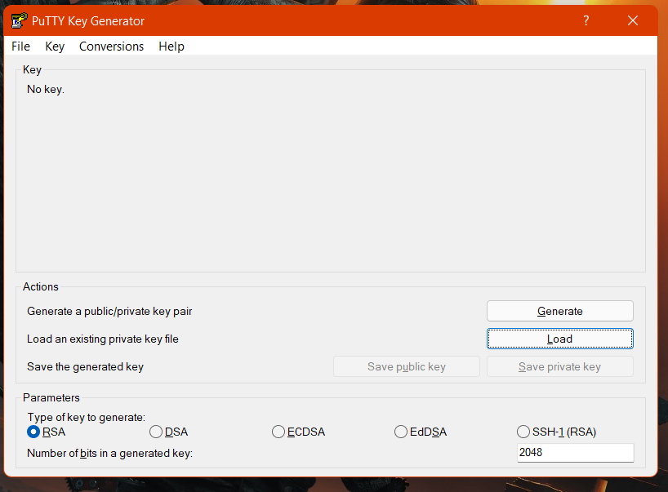
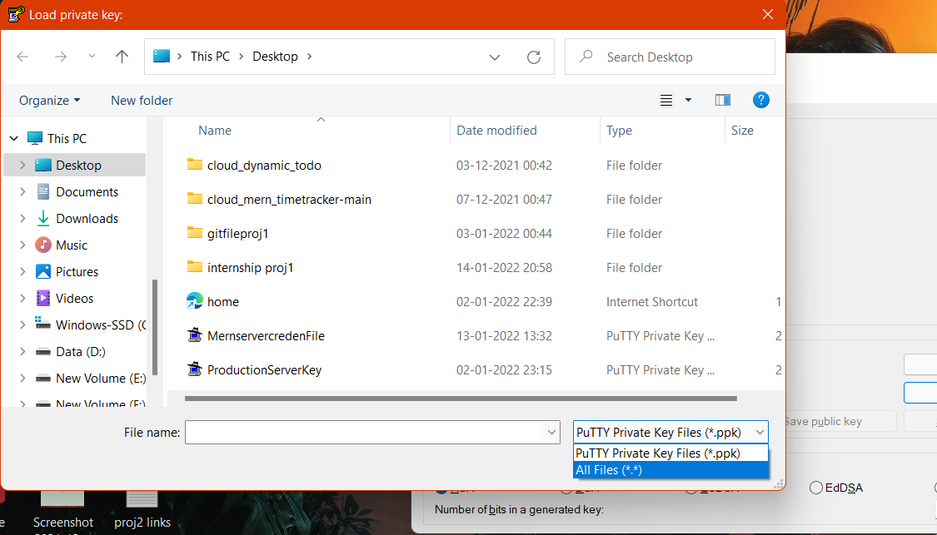
Now we load the keypair in the PuTTygen .the keypair that we downloaded before.

Slide 10
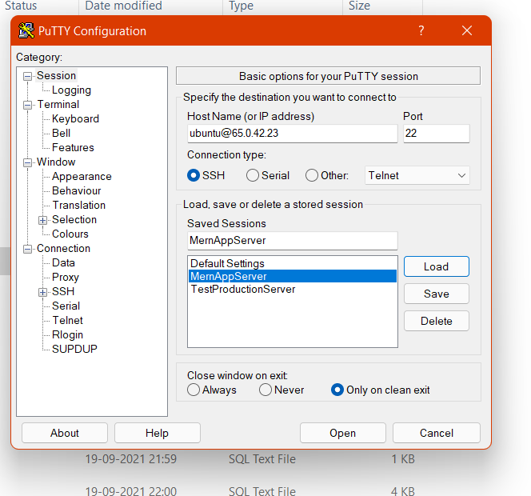
After load the keypair in puttygen I create a session in putty by name “MernAppServer”

Slide 11
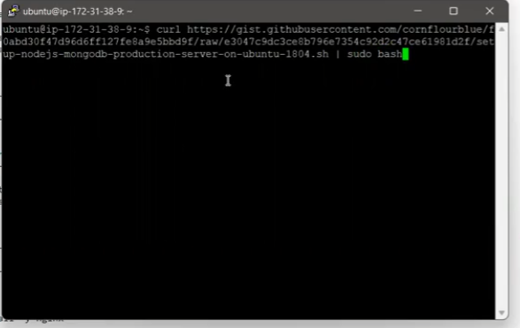
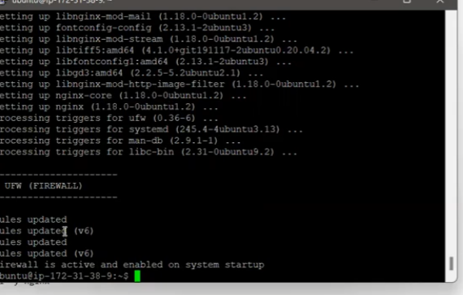
Now we need to setup nginx mongo and nodejs for server to prepare
Here we run this script in terminal and wait for it to install

Slide 12
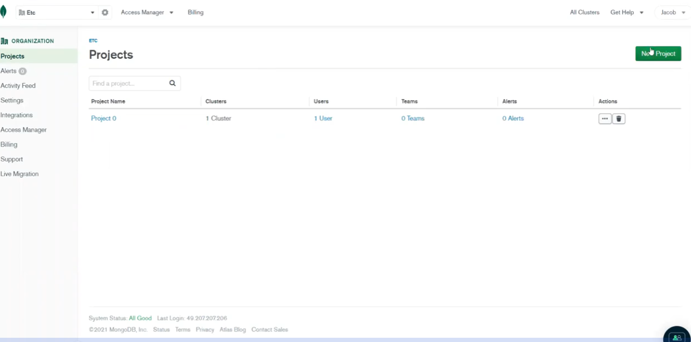
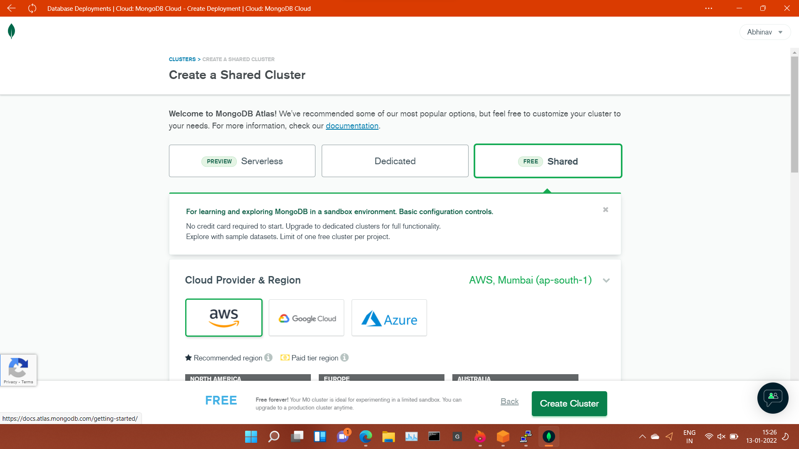
Sign in mongo atlas start new project
We create a database (a shared one)
Choose AWS as cloud provider

Slide 13
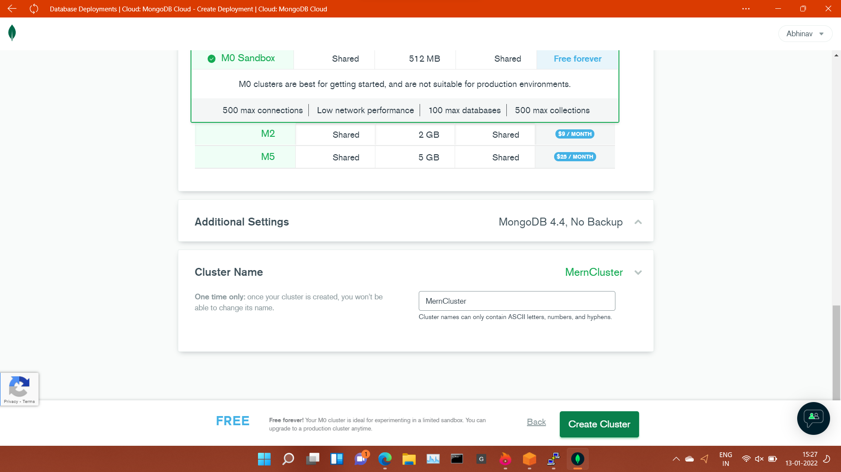
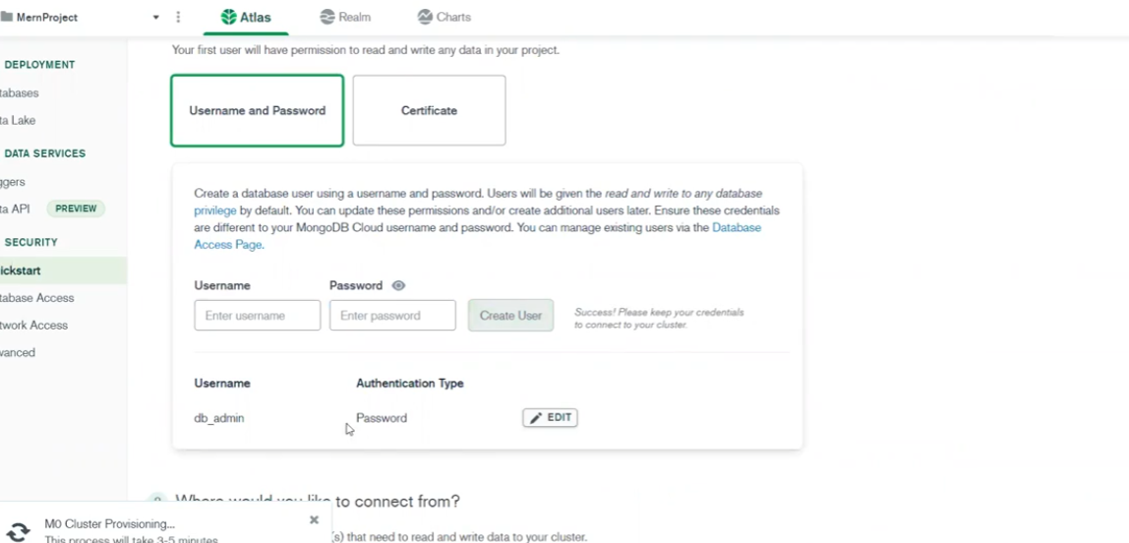
Then choose a sandbox cluster
Name it as MernCluster
Set username and password

Slide 14
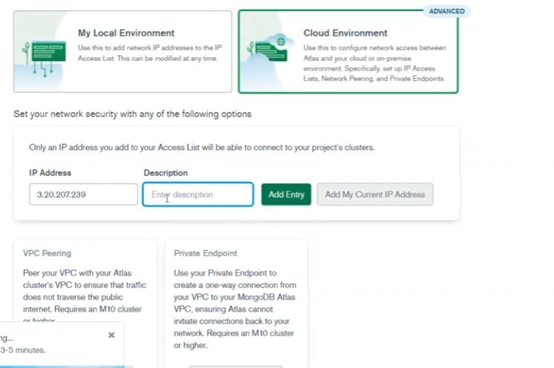
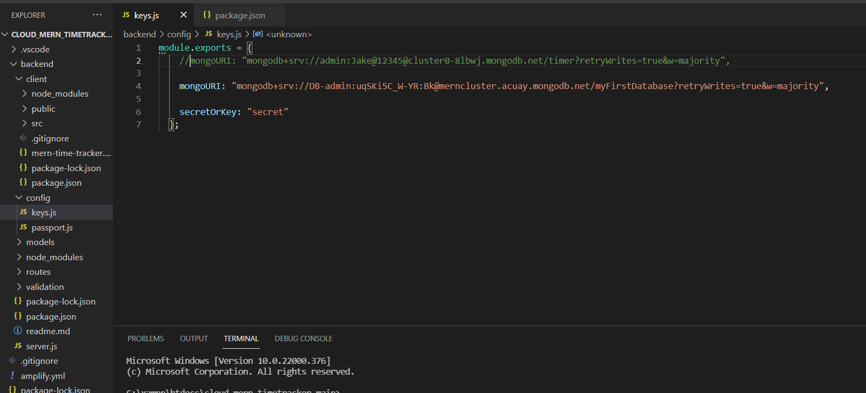
Select cloud environment add ip address from the instance
Connect database to merncluster

Slide 15
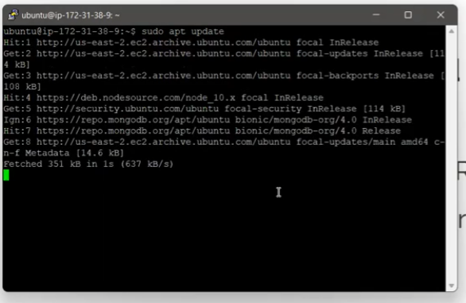
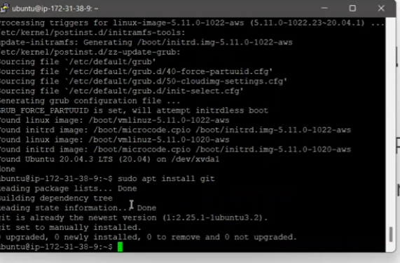
Update terminal using “sudo apt update ” command
Install git in terminal

Slide 16
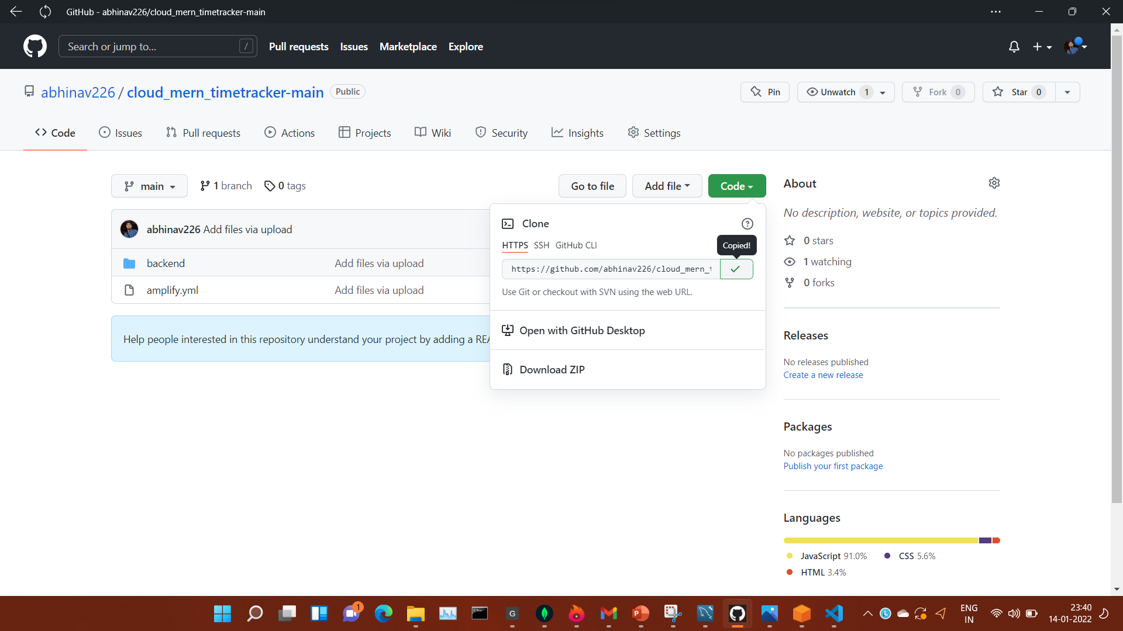
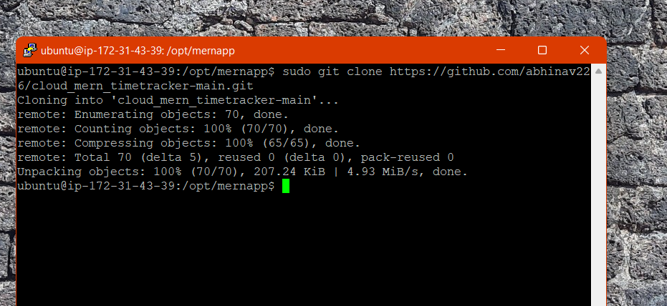
Copy link from github and paste it on terminal in mernapp to download the app on your machine

Slide 17
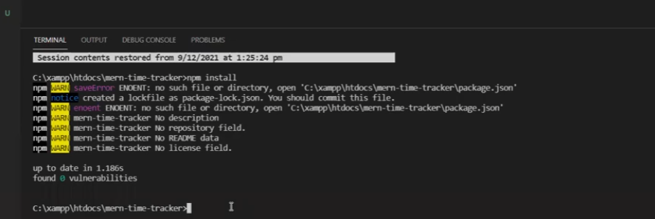
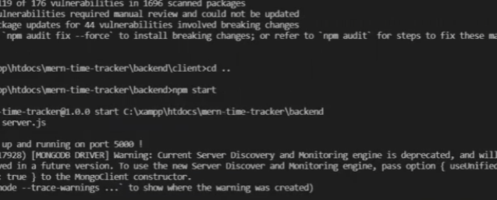
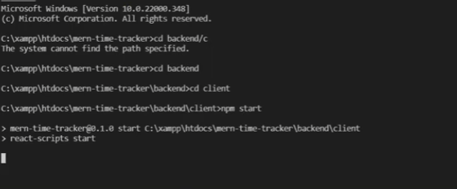
Install npm package manager in vscode terminal
(in backend and client folder)
To fix vulnerability enter “npm audit fix” command
Now come back to the backend folder and start npm

Slide 18
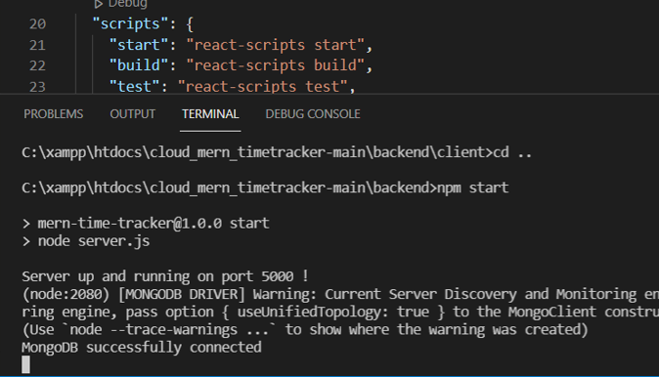
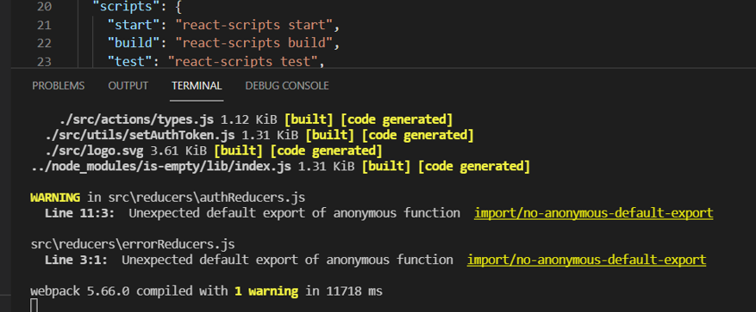
Here you can see mongoDB successfully connected
Now application will start in a while you can see it on the next slide

Slide 19
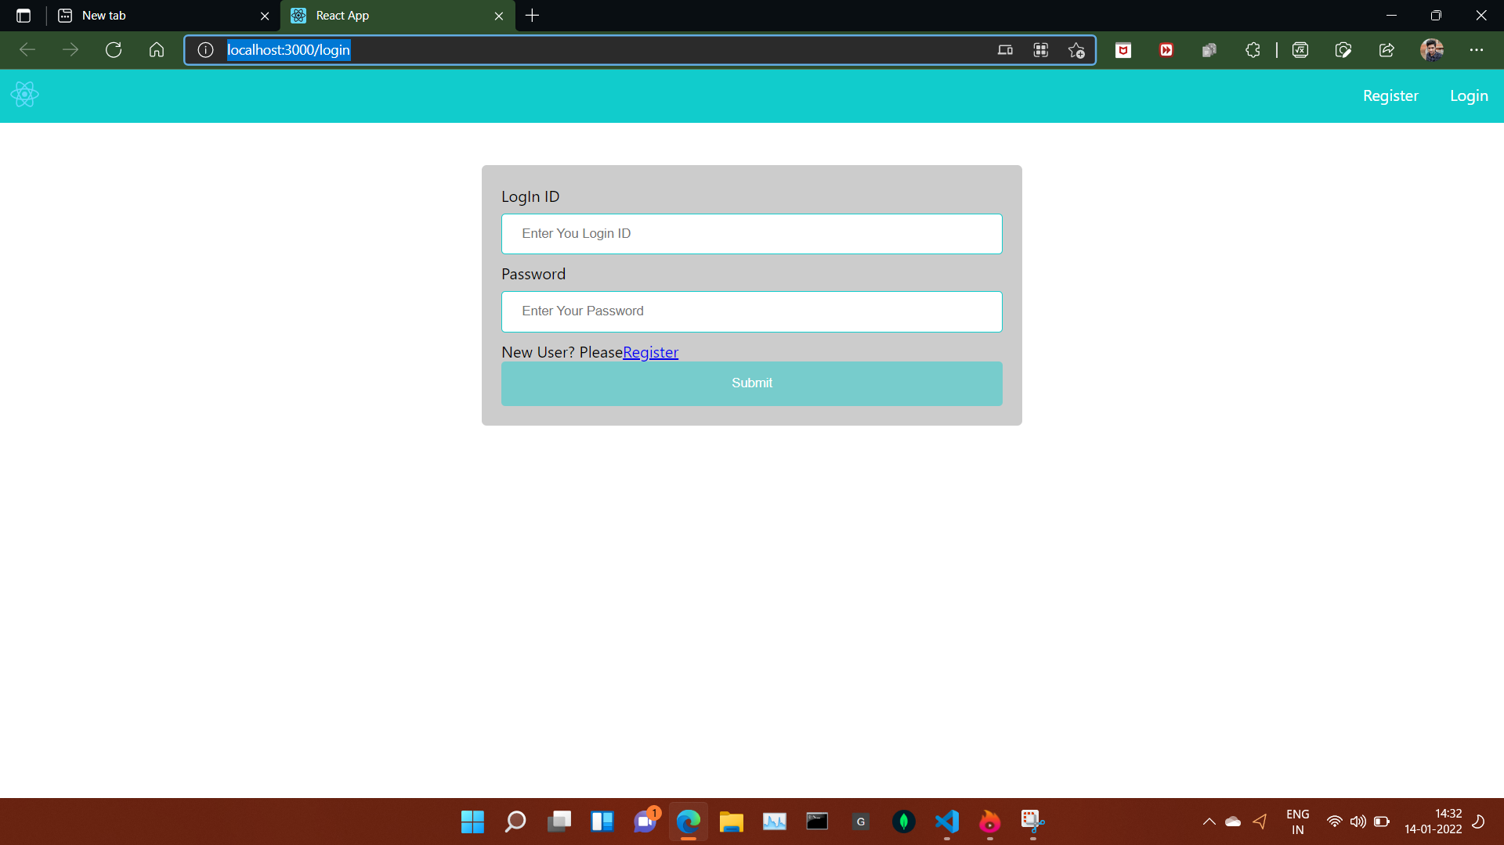

Slide 20
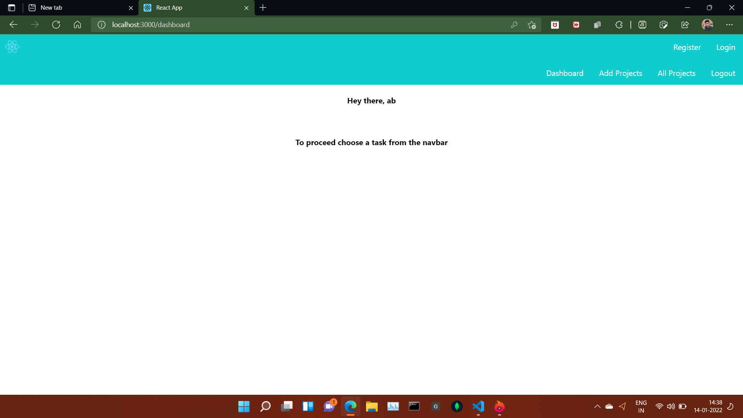
Register as ‘ab’
Email: ab123@email.com

Slide 21
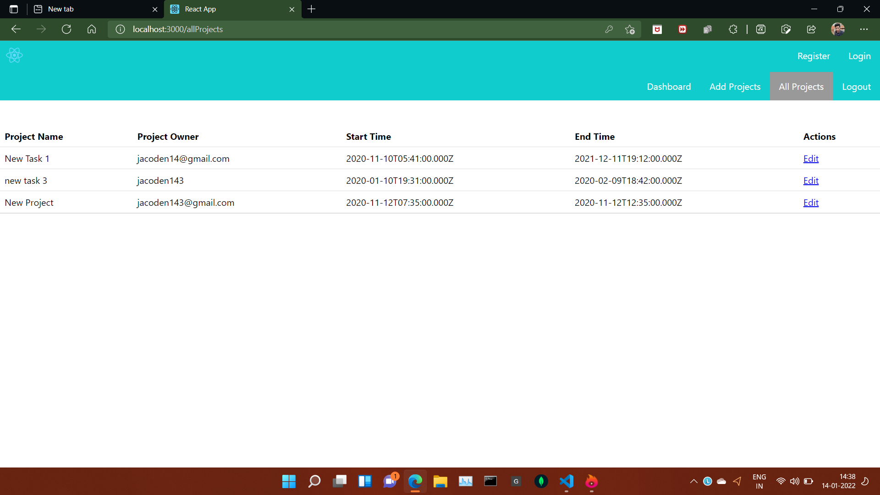
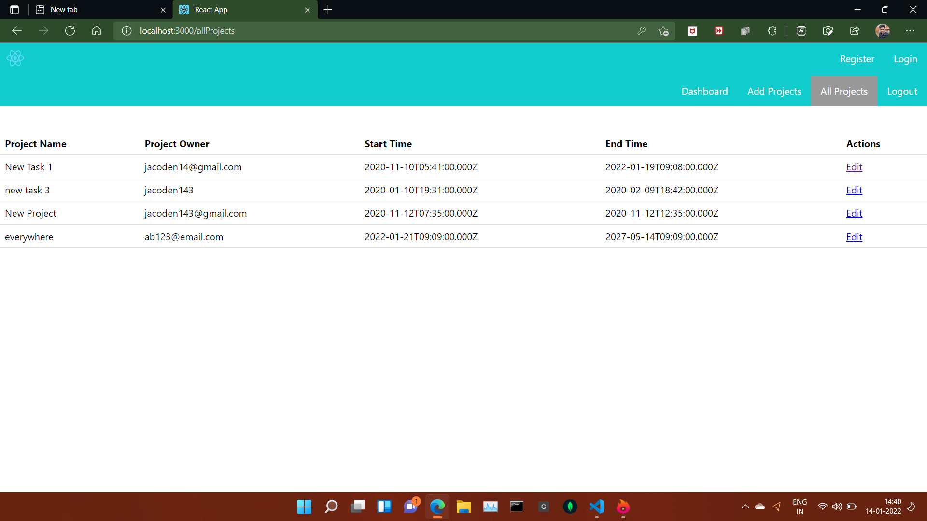
Default projects in all projects section
After adding a new project called “everywhere” as ‘ab’

Slide 22
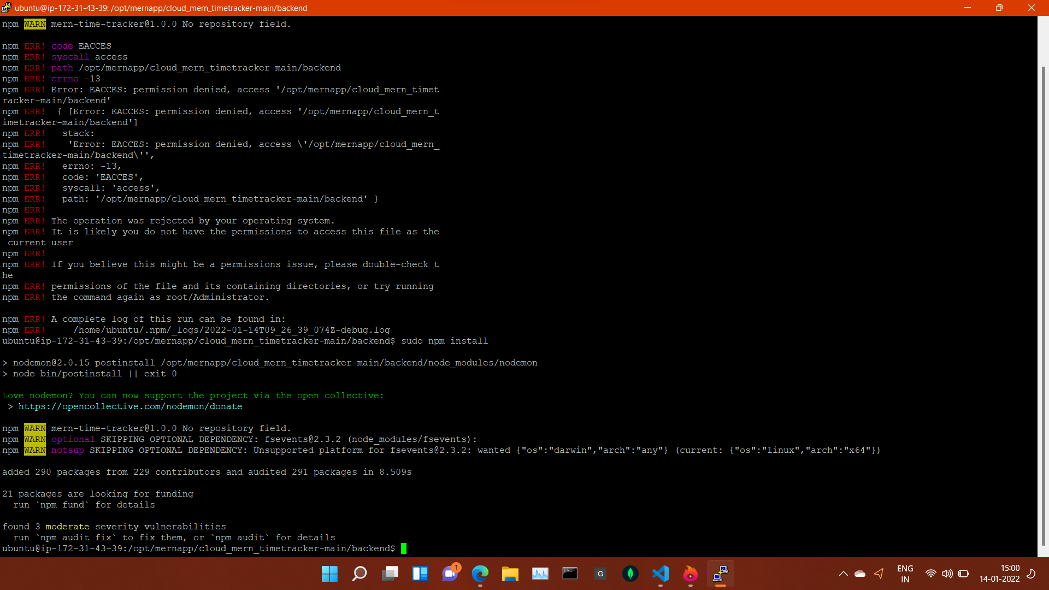
Install npm in backend

Slide 23
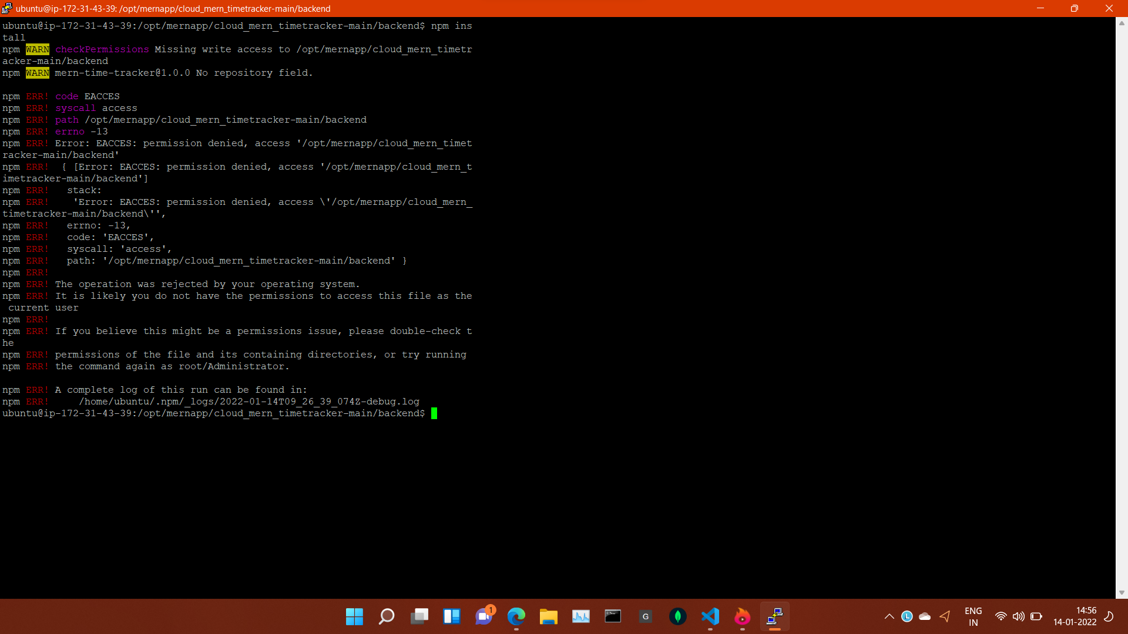

Slide 24
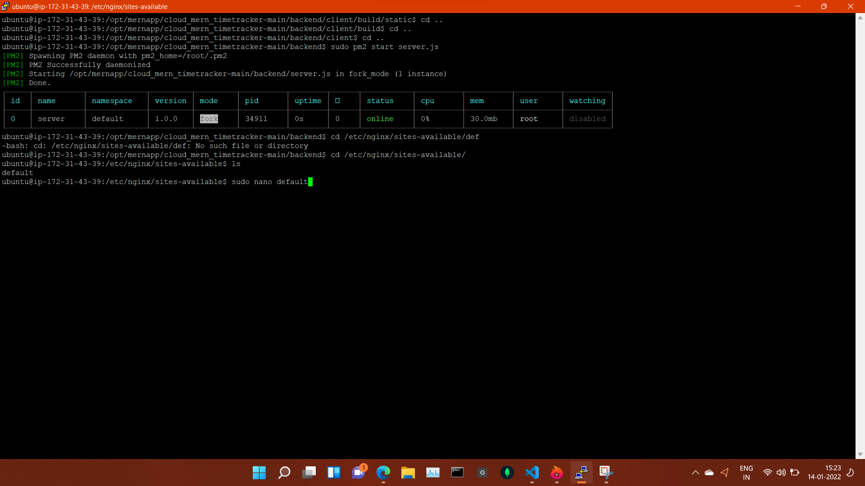
Start server

Slide 25
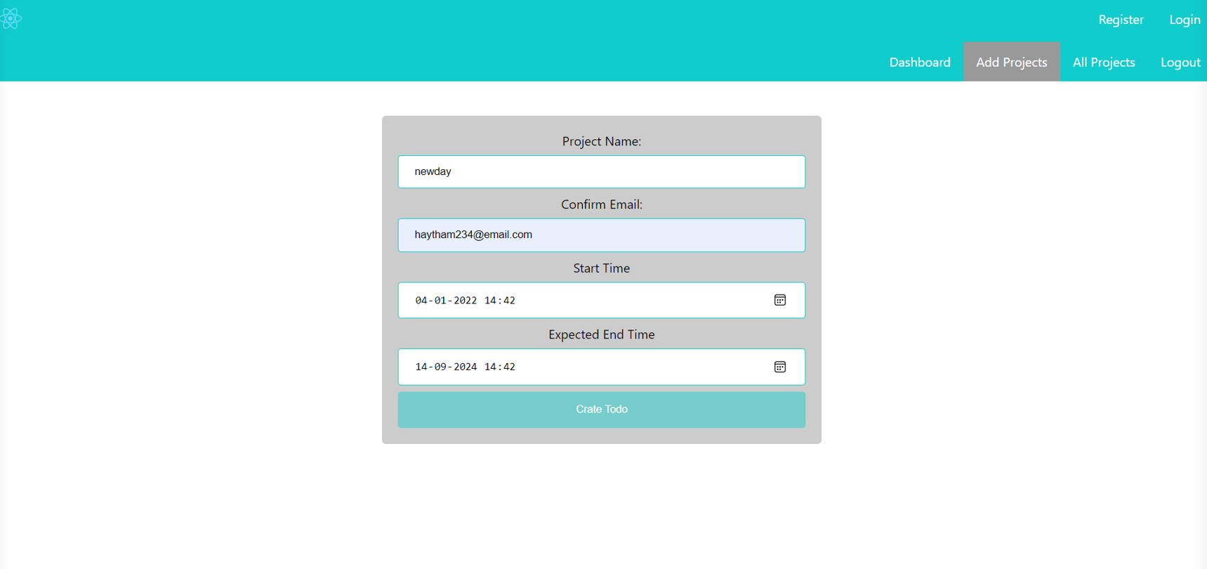
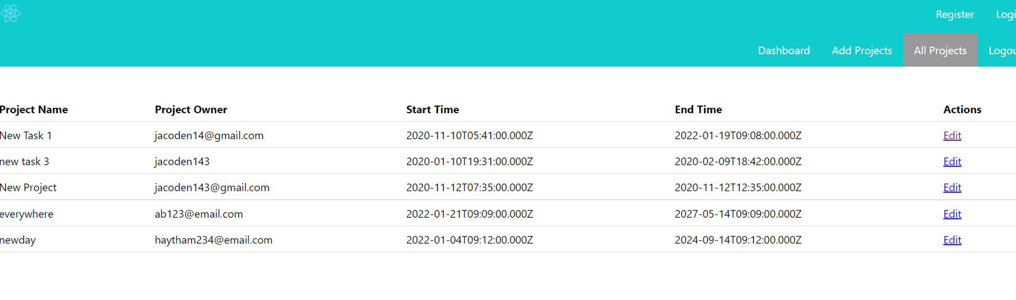
Entering a project called ‘newday’ as ‘Haytham’
Successfully enter a project

Slide 26
Thank you
By Abhinav suman

